Slide 1
Fog of War
Ferran Martín Vilà

Slide 3
Todo 1
Create fog layer!

Slide 4
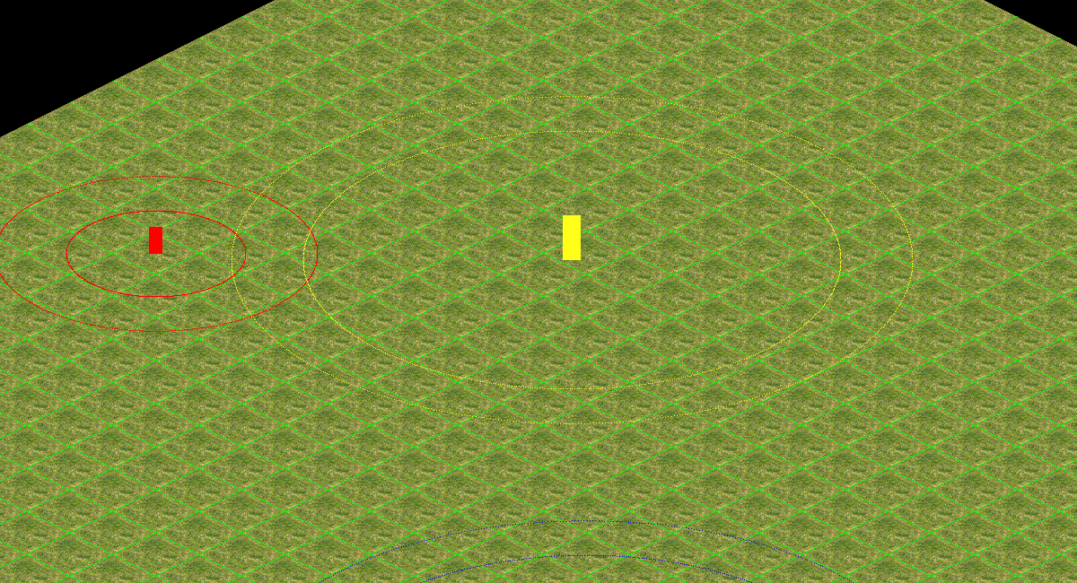
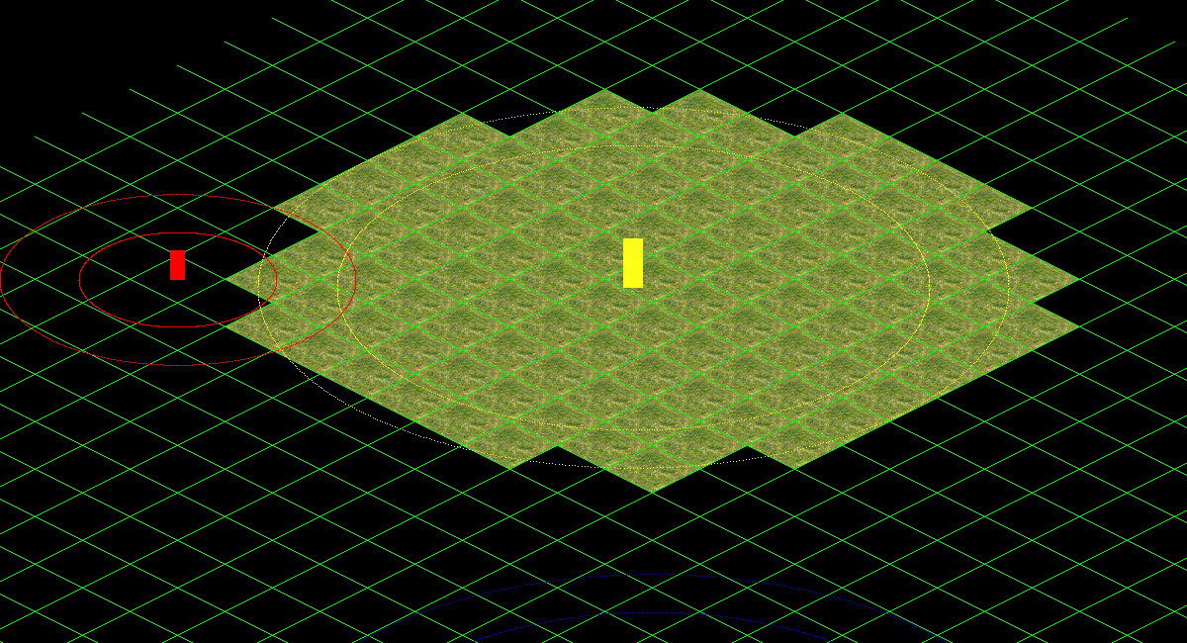
Todo 2
- Map Optimization!

Slide 5
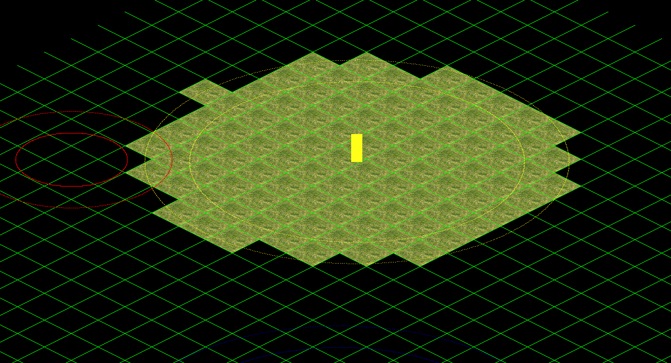
Todo 3
- Entities draw optimization!

Slide 6
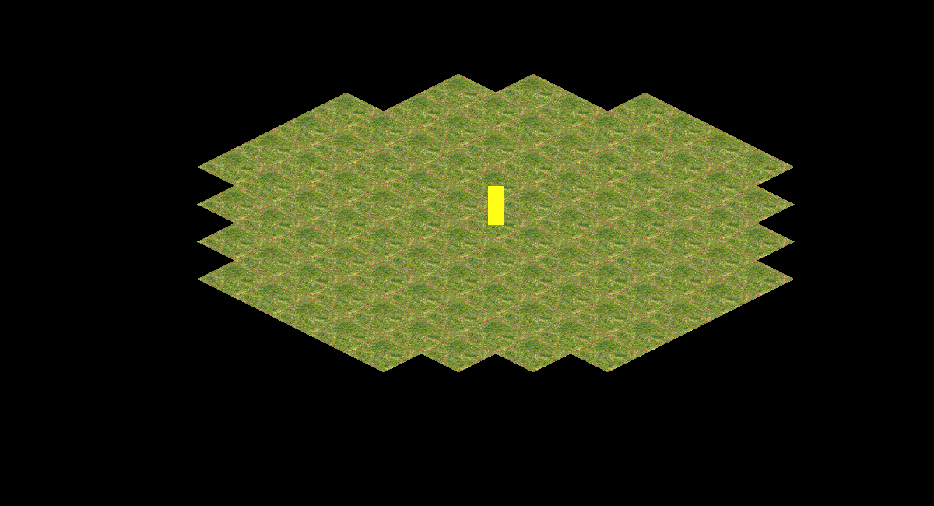

Todo 4
Draw alpha layer!
Use app debug mode to actívate/deactivate the fog draw

Slide 7
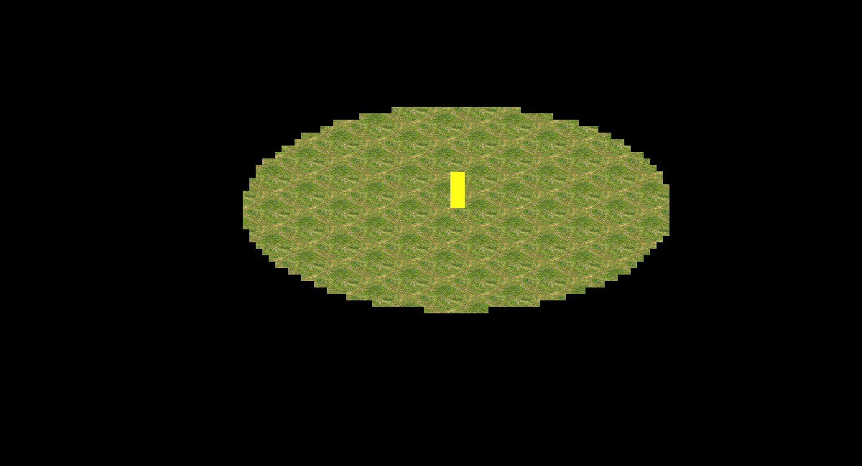
Todo 5
- Make ally entities clear alpha layer!

Slide 8
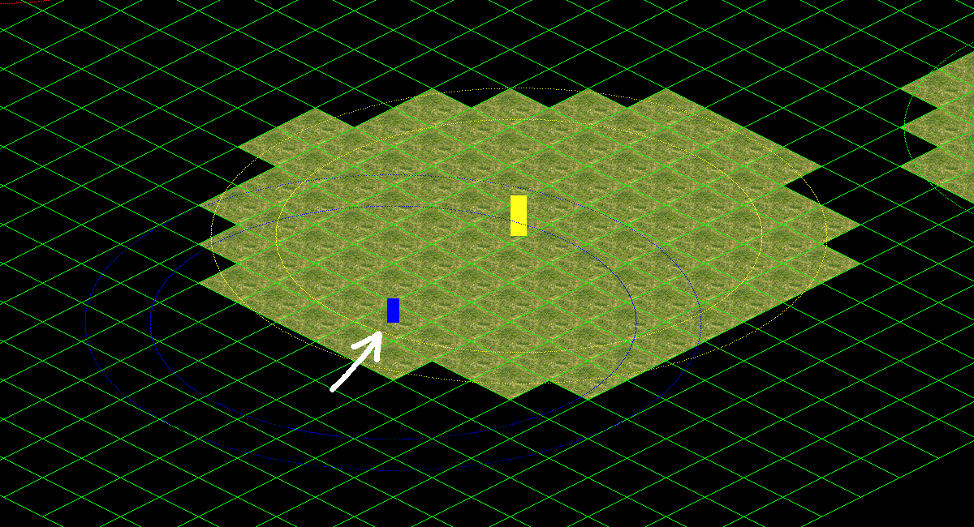
Todo 6
Make player check his vision area!
Fill CheckVisionArea entity method and call it from player update.

Slide 9
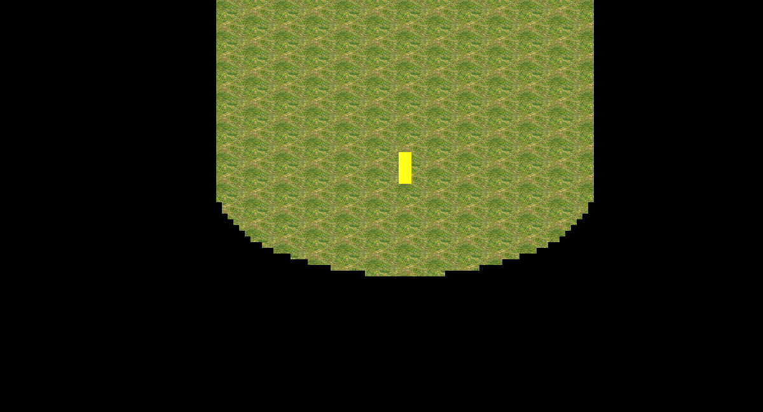
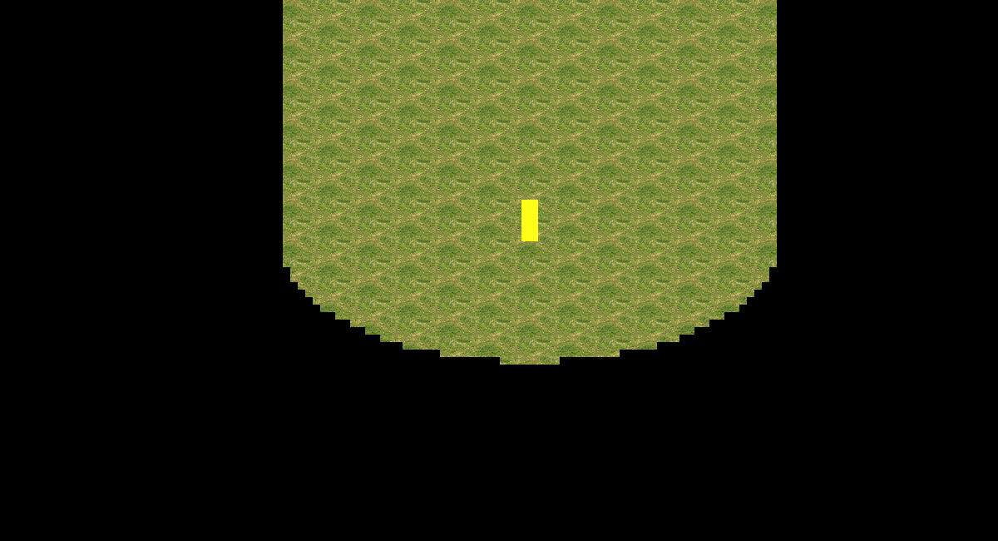
Todo 7
- Clear fog area when a neutral entity is detected!

Slide 10
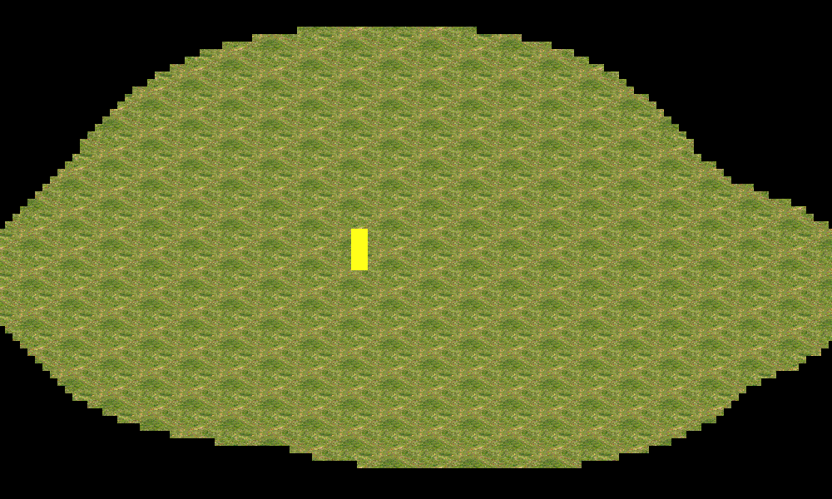
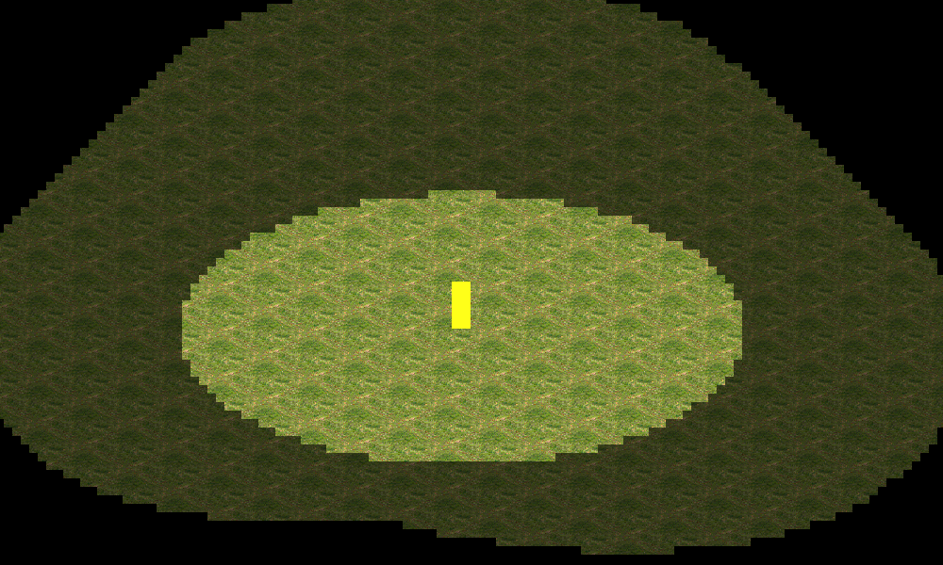
Todo 8
- Update alpha layer!

Slide 11

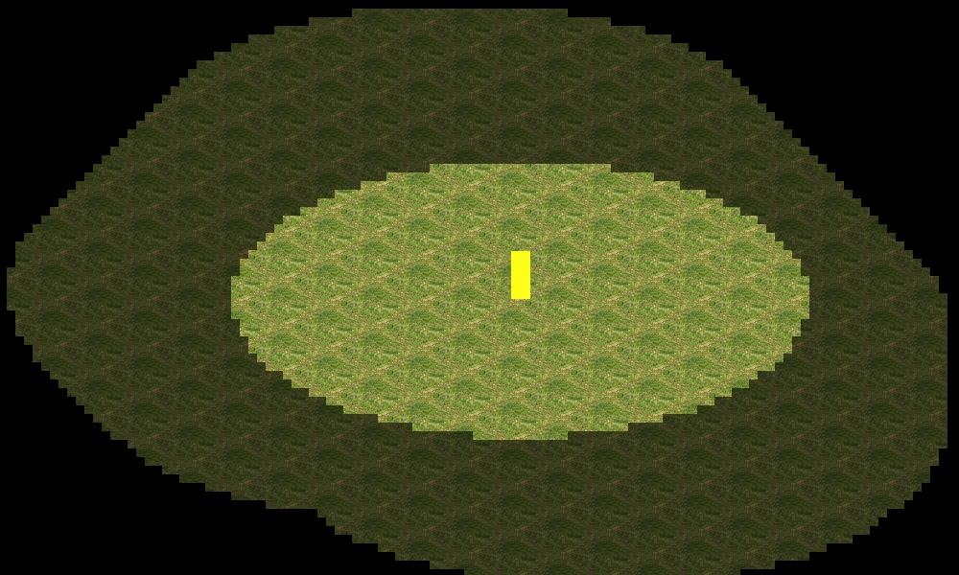
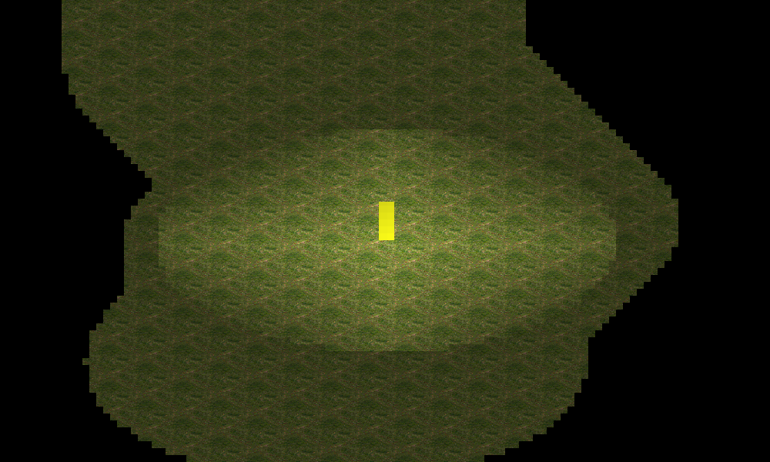
Extra Work!
- Create a function to smooth the fog alpha layer and iterate it!

Slide 12
More Info…

Slide 13

And thats it!
Contact me!
GitHub: https://github.com/ferranmartinvila
Gmail: ferranmartinvila21@gmail.com

